Slide 1
Feasibility Analysis
Ref: Whitten et all, Systems Analysis and Design Methods 7e. McGraw-Hill Higher Education
Mostafijur Rahman Akhond
Lecture, CSE
BRAC University

Slide 2
Key Ideas
Projects are initiated to create business value using the information technology.
Business needs:
  Lower cost/Increase revenue
  Improve customer service
  Use latest/emerging technologies
  And many more …
Slide <number>

Slide 3
Key Ideas
A system request presents
  a brief summary of a business need
  explains how a system that supports the need will create business value.
The project sponsor is a key person
  Recognize business need
  Understand business value
  Adoption of new IT
  Want system to succeed
The approval committee
  reviews proposals from various groups and units
  Approve/decline/suspend projects
Slide <number>

Slide 4
Identifying Business Values
Slide <number>

Slide 5
Business value
Tangible value can be quantified and measured easily, e.g.
  2% reduction in operating costs
  5% increase in sales
Intangible value – system provides important but hard-to-measure benefits, e.g.
  improved customer service
  better competitive position
Slide <number>

Slide 6
System Request
Describes business reasons for building a system – the business value
Project sponsor prepares the document
Approval committee reviews and judges the system request
Slide <number>

Slide 7
System Request
Lists key elements of the project
  Project sponsor
  Business need
  Business requirements
  Business value
  Special issues or constraints
Slide <number>

Slide 8
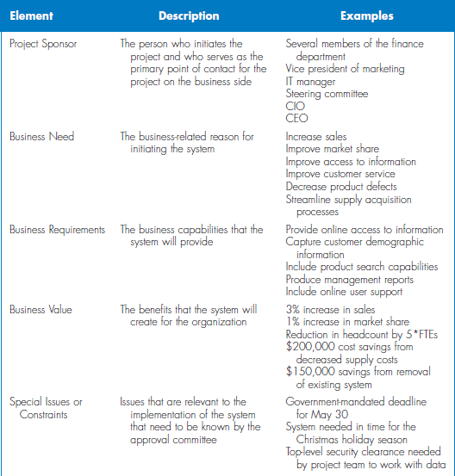
Slide <number>

Slide 9
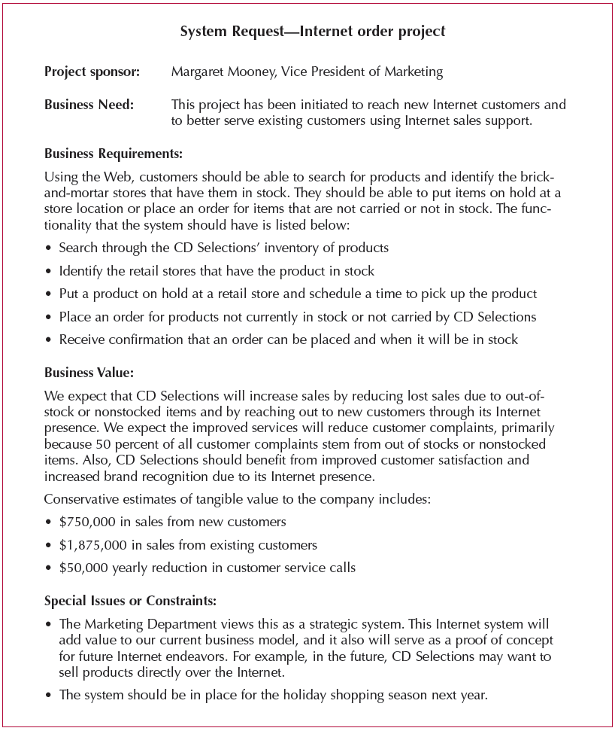
Sample System Request
Slide <number>

Slide 10
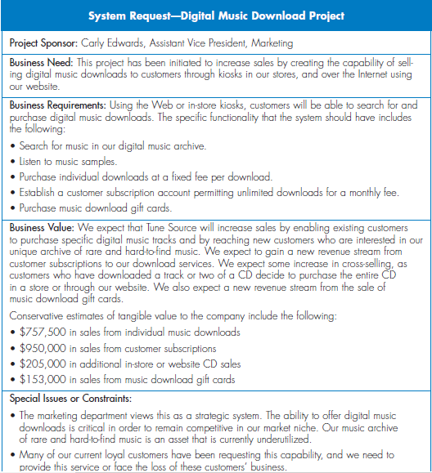
Slide <number>

Slide 11
Your Turn
If you were building a web-based system for course enrollment --
  What would be the functionality?
  What would be the expected value?
  What special issues or constraints would you foresee?
Slide <number>

Slide 12
Feasibility Analysis
Slide <number>

Slide 13
Key Ideas
Feasibility analysis is used to aid in the decision of whether or not to proceed with the IS project.
Also identifies project risks
Can be revised throughout SDLC
Slide <number>

Slide 14
Feasibility Analysis
Detailing Expected Costs and Benefits
  Technical feasibility
  Organizational feasibility
  Economic feasibility
Slide <number>

Slide 15
Technical Feasibility:
Can We Build It?
Familiarity with application
  Knowledge of business domain
Familiarity with technology
  Extension of existing firm technologies
Project size
  Number of people, time, and features
Compatibility
  Ease of integrating the system with the company’s existing technology
Slide <number>

Slide 16
Organizational Feasibility
If we build it, will they come?
Will the users accept the system?
Will it be incorporated in the organization?
How to asses?
  1. Check Strategic Alignment – fit between project and business strategy?
Slide <number>

Slide 17
Organizational Feasibility
If we build it, will they come?
2. Perform Stakeholder Analysis
Stakeholder – any person, group, or organization that can affect or will be affected by the system
Stakeholder analysis considers
  Project champion(s)
  Organizational management
  System users
Slide <number>

Slide 18
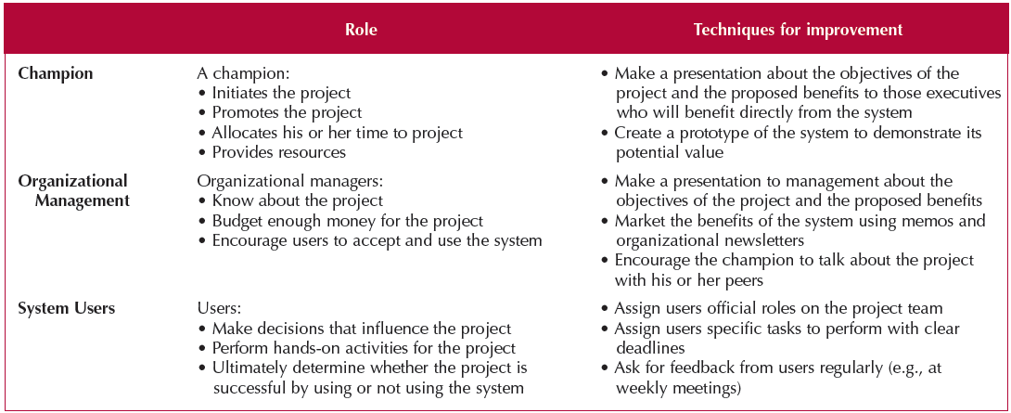
Stakeholders
Slide <number>

Slide 19
Economic Feasibility
Should We Build It?
Perform cost benefit analysis
  Identify costs and benefits
  Assign values
  Calculate cash flow and ROI
Development costs
Annual operational costs
Annual benefits
Intangible costs and benefit
Slide <number>

Slide 20
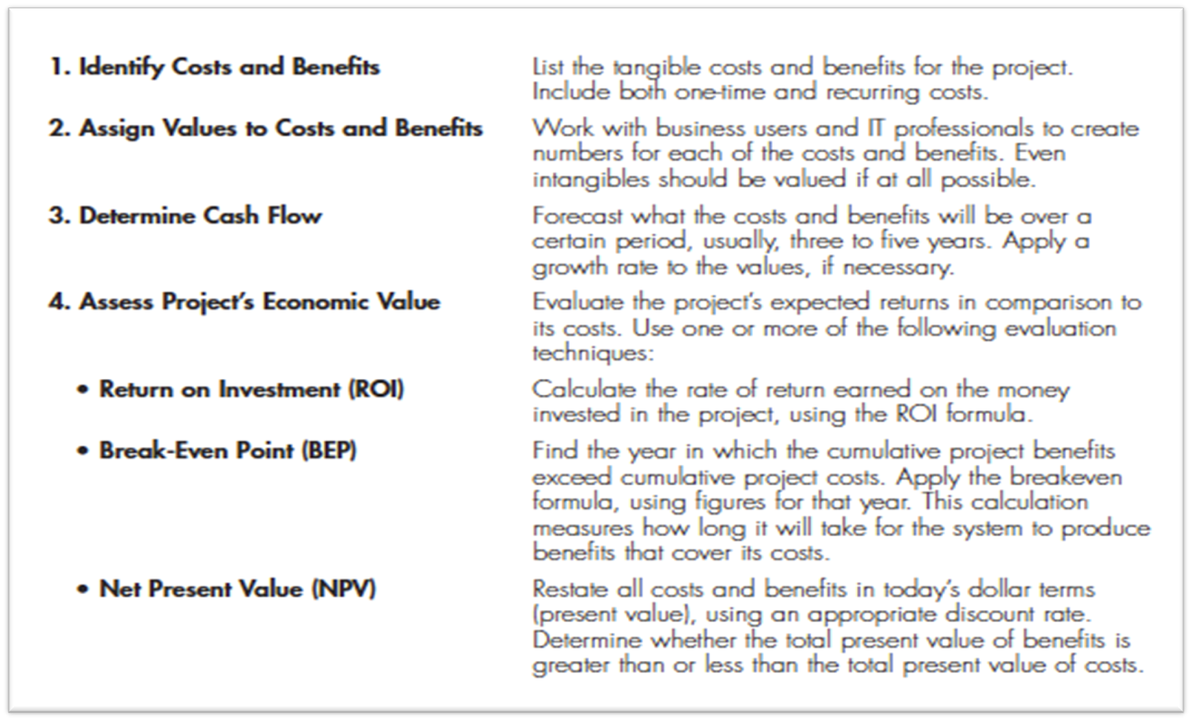
Economic Feasibility Steps
Slide <number>

Slide 21
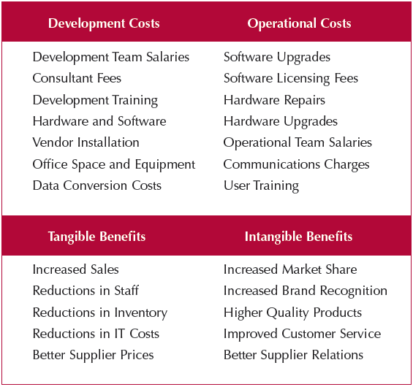
Example Cost & Benefits
Slide <number>

Slide 22
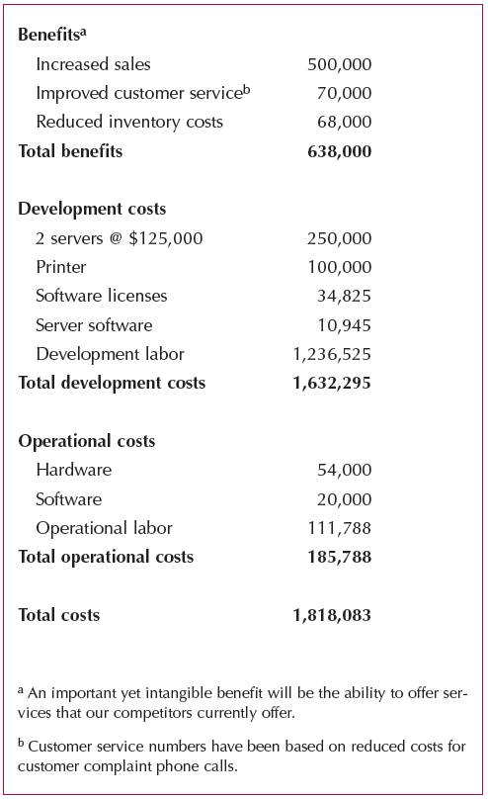
Assign Values
Slide <number>

Slide 23
Expected Value
Costs
Benefits
Tangible
*
*
*
*
*
*
*
*
*
*
*
*
Intangible
Slide <number>

Slide 24
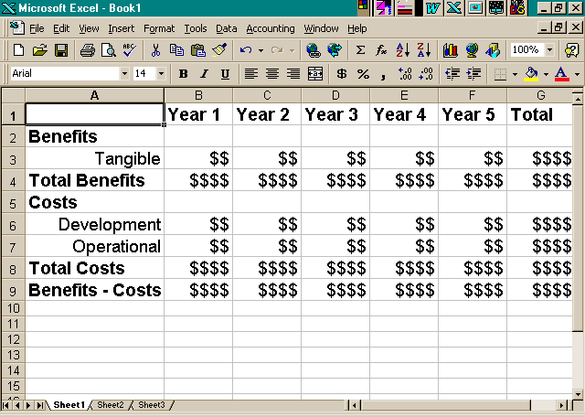
Cash Flow Method for Cost Benefit Analysis
Slide <number>

Slide 25
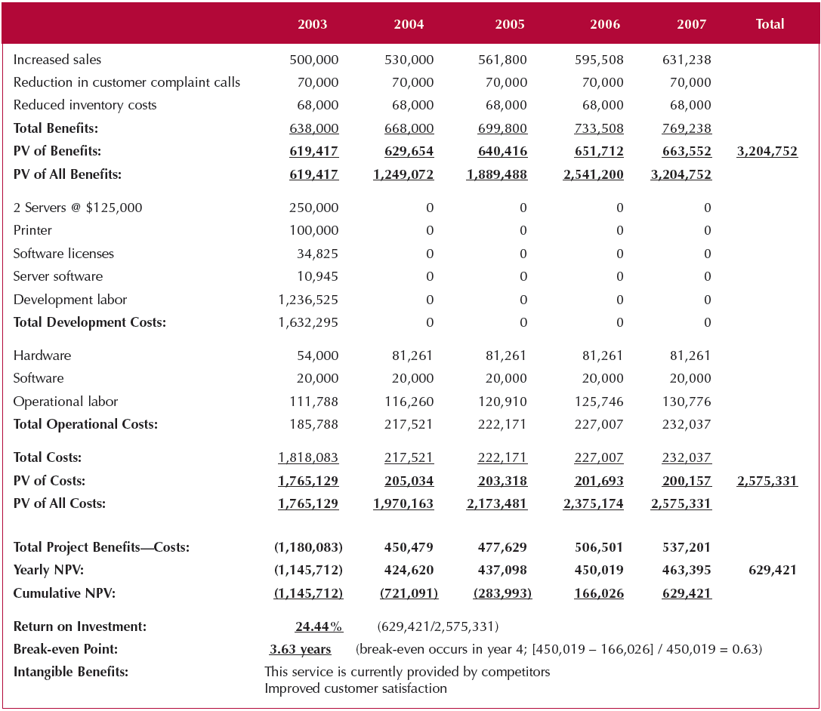
Cost-Benefit Analysis
Slide <number>

Slide 26

Present Value Calculation
PRESENT VALUE EQUALS
Cash flow amount
Divided by
(1 + interest rate)^{n}
Where “n” equals the number of periods
$100 received in 3 years with a required rate of return of 10% has a PV of $75.13.
Slide <number>

Slide 27

Net Present Value (NPV)
The NPV is simply the difference between the total present value of the benefits and the total present value of the costs.
Slide <number>

Slide 28
Return on Investment (ROI)
Measures money received in return for money invested
High ROI is desirable when benefits exceed costs
Can be determined per year, or for entire project completion period
Slide <number>

Slide 29
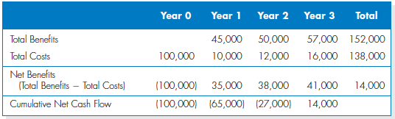
Return on Investment Calculation
Slide <number>

Slide 30
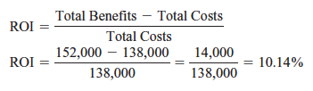
Return on Investment Calculation
Slide <number>

Slide 31
Break-Even point
Length of time when returns will match amount invested
Greater time -> Greater risks
Easier to picture graphically – plot cumulative present value of benefits and costs for each year
Slide <number>

Slide 32
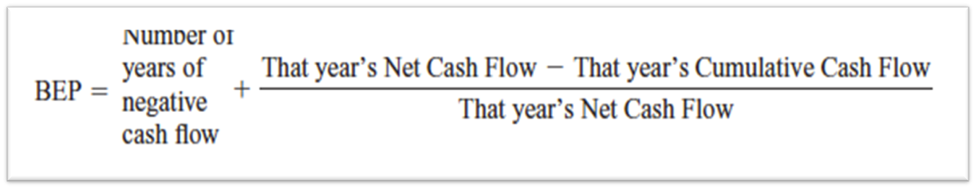
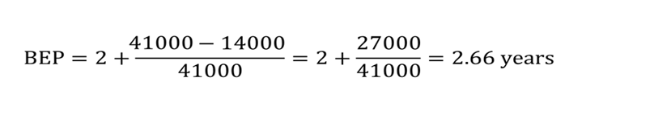
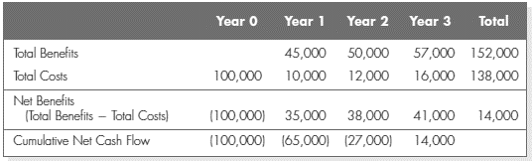
Break-Even point
Slide <number>

Slide 33
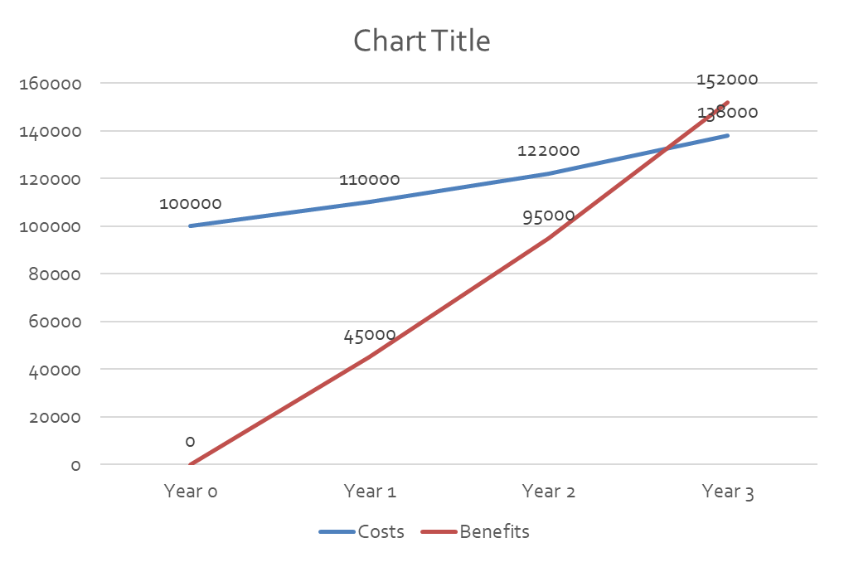
Break-Even Graph
Slide <number>

Slide 34
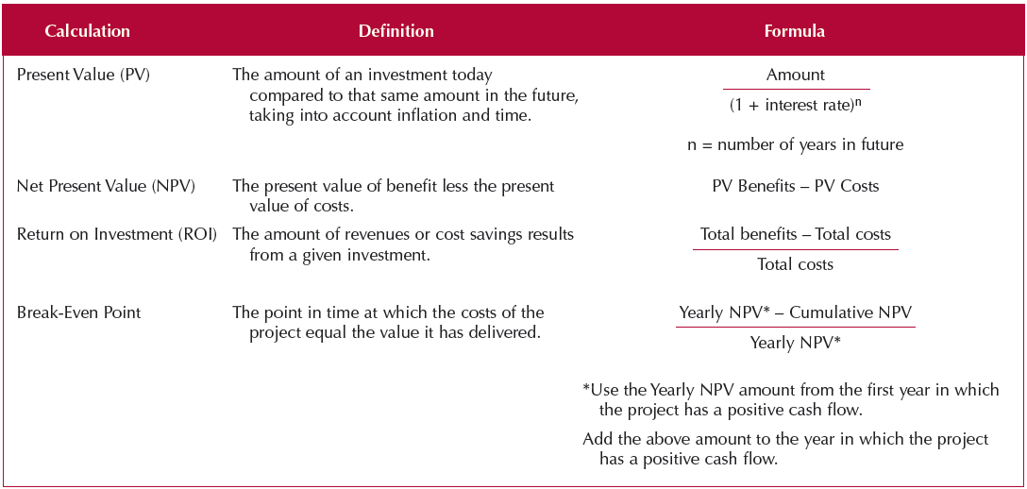
Formulas
Slide <number>

Slide 35
Summary
Project initiation involves creating and assessing goals and expectations for a new system
Identifying the business value of the new project is a key to success
The system request describes an overview of the proposed system.
The feasibility study is concerned with ensuring that technical, economic, and organizational benefits outweigh costs and risks
Slide <number>

